Slide 1
White Box Testing

Slide 2
White Box Design
Called glass-box testing also.
Uses the control structure of the procedural design to derive test cases.
Using white-box testing we can derive test cases that
  guarantee that all independent paths within a module have been exercised at least once,
  exercise all logical decisions on their true and false sides,
  execute all loops at their boundaries and within their operational bounds,
  and exercise internal data structures to ensure their validity.

Slide 3
White Box Design
"Why spend time and energy worrying about (and testing) logics when we might better expend effort ensuring that program requirements have been met?“
OR
Why don't we spend all of our energy on black-box tests?

Slide 4
White Box Design
The answer lies in the nature of software defects:
  Logic errors and incorrect assumptions are inversely proportional to the probability that a program path will be executed
  We often believe that a logical path is not likely to be executed when, in fact, it may be executed on a regular basis.
  Typographical errors are random
Each of these reasons provides an argument for conducting white-box tests.

Slide 5
White-Box Testing
Statement coverage
Branch coverage
Path coverage
Condition coverage

Slide 6
Statement coverage
Programs constructs can be usually classified as:
1. Sequential control flow
2. Two way decision statements (if then else)
3. Multi way decision statements (switch)
4. Loops (while, do, repeat until, for)

Slide 7
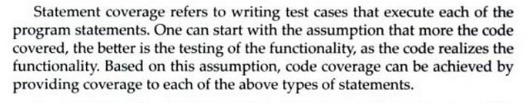
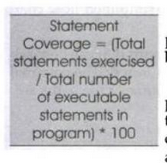

Slide 8
A good percentage of defects comes because of loops that do not function properly.
Most often loops fail in what are called as boundary conditions.
One of the most common looping error is that termination condition of loop is not properly stated.
For better statement coverage for statements within loop there should be test cases that:
1. Skip the loop completely.
2. Exercise the loop between once and maximum no. of times.
3. Try covering loop around the boundary.

Slide 9
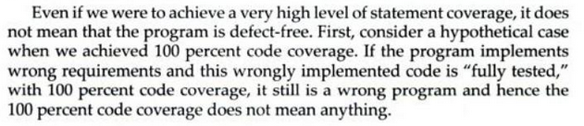
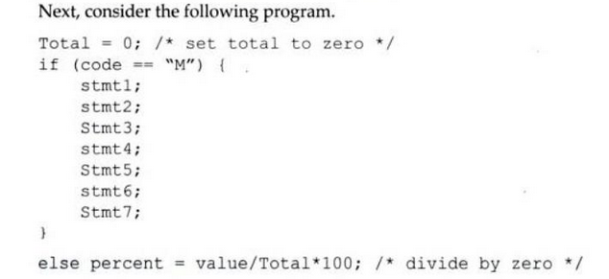
Exhaustive coverage of all statements in a program will be practically impossible.

Slide 10

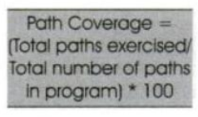
Path Coverage

Slide 11
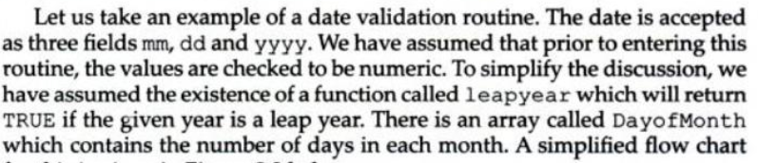

Slide 12
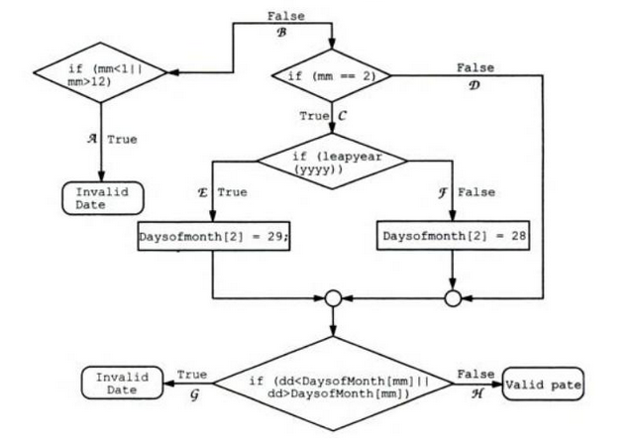

Slide 13



Slide 14
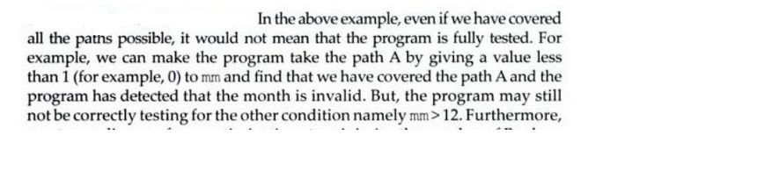
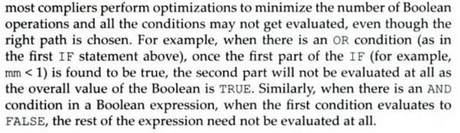
Condition Coverage

Slide 15
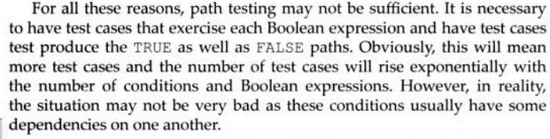
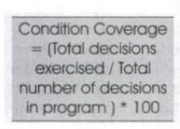

Slide 16
Control flow graph (CFG)
A control flow graph (CFG) describes:
  the sequence in which different instructions of a program get executed.
  the way control flows through the program.
  How to draw Control flow graph?
Number all the statements of a program.
Numbered statements:
  represent nodes of the control flow graph.
An edge from one node to another node exists:
  if execution of the statement representing the first node can result in transfer of control to the other node.

Slide 17
Example
1
int f1(int x,int y){
while (x != y){
if (x>y) then
x=x-y;
else y=y-x;
}
return x; }
2
3
4
5
6

